Slide 1

Visualize Azure Network Traffic
Using flow logs and traffic analytics

Slide 2



Introduction
Who am I?
Cloud Consultant @ OGD-ict diensten
IAC, CI/CD, Automation, Agile, DevOps
Previous experiences:
Technical Lead SysOps Team
SysOps Engineer
Functional Application Specialist
PHP Backend Developer
Twitter: @AutoSysOps Blog: www.autosysops.com

Slide 3
Introduction
Agenda
Zero trust and cloud networking
Introduction into Azure Networking
Common mistakes
Flow Logs
Traffic Analytics
Detecting mistakes

Slide 4
Zero trust
and cloud networking

Slide 5

Zero trust
What is zero trust?
Verify explicitly

Slide 6

Zero trust
What is zero trust?
Verify explicitly
Use least privileged access

Slide 7

Zero trust
What is zero trust?
Verify explicitly
Use least privileged access
Assume breach

Slide 8

Zero trust
Zero trust in the cloud
Verify explicitly
Build in authentication & authorization
Connections to on-prem auth

Slide 9
Zero trust
Zero trust in the cloud
Verify explicitly
Build in authentication & authorization
Connections to on-prem auth
Use least privileged access
Very granular permissions
Multiple permission model

Slide 10
Zero trust
Zero trust in the cloud
Verify explicitly
Build in authentication & authorization
Connections to on-prem auth
Use least privileged access
Very granular permissions
Multiple permission models
Assume breach
Bigger attack surface

Slide 11
Azure Networking
Introduction

Slide 12
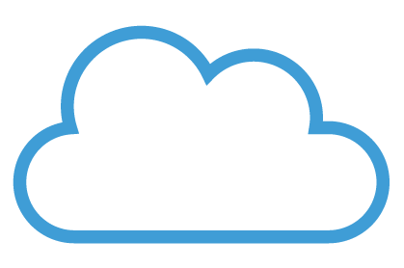
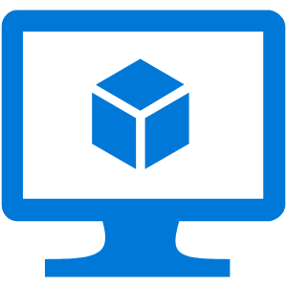

Azure Networking
Networking resources in Azure
Public endpoints / Public IP
Routing Internet / Azure backbone
Private endpoints / Private IP
Routing Vnet

Slide 13

Azure Networking
Virtual Networks
Vnet (10.0.0.0/16)
Subnet (10.0.0.0/24)
Subnet (10.0.1.0/24)
Subnet (10.0.2.0/24)
Vnet
Address spaces
Peerings
DNS Servers
Subnet
Address range
NAT gateway
Network Security Group

Slide 14

Azure Networking
Network Interfaces

Slide 15

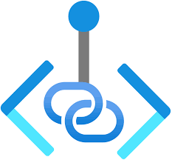

Azure Networking
Private Link
Public Endpoint
Private Link
Private DNS Zone

Slide 16
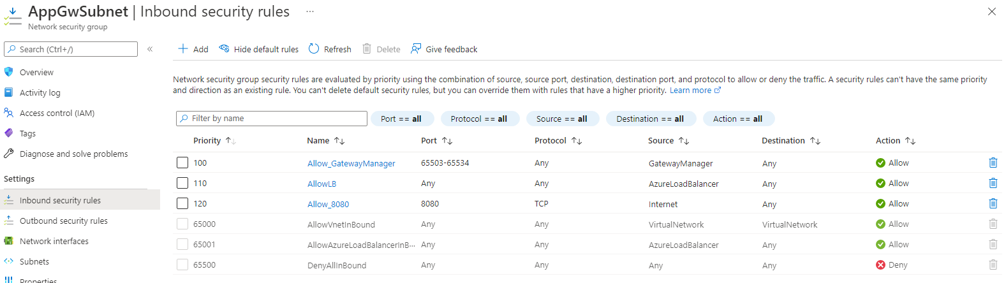
Azure Networking
Network Security Group

Slide 17

Azure Networking
Nat Gateway – Outbound connections
Public IP
Public IP

Slide 18
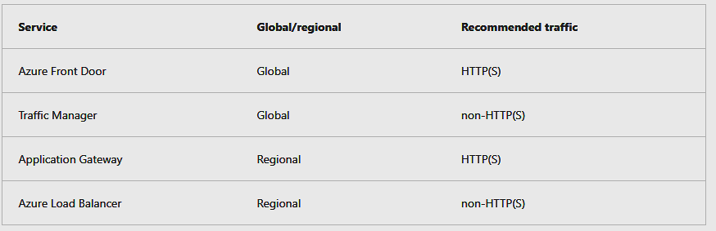

Azure Networking
Application Gateway – Inbound Connections

Slide 19
Common Mistakes
In Azure Networking

Slide 20
Common Mistakes
It’s always something!
Symptoms:
Traffic to resources with private endpoint use public endpoint or are blocked

Slide 21
Common Mistakes
It’s always DNS!
Symptoms:
Traffic to resources with private endpoint use public endpoint or are blocked
Reasons:
DNS Zones aren’t linked to the Vnet so public DNS resolution is used

Slide 22
Common Mistakes
It’s always DNS!
Symptoms:
Traffic to resources with private endpoint use public endpoint or are blocked
Reasons:
DNS Zones aren’t linked to the Vnet so public DNS resolution is used
Mitigation:
Link the Private DNS Zones
(Optional) Remove the public endpoint

Slide 23
Common Mistakes
Where did my data go?
Symptoms:
Software is directly targeted by attacks like SQL injection

Slide 24
Common Mistakes
Bobby Drop Tables
Symptoms:
Software is directly targeted by attacks like SQL injection
Reasons:
Software Host has public IP accessible so WAF can be circumvented

Slide 25
Common Mistakes
Bobby Drop Tables
Symptoms:
Software is directly targeted by attacks like SQL injection
Reasons:
Software Host has public IP accessible so WAF can be circumvented
Mitigation:
Block access to the public IP
(Optional) Remove the public IP

Slide 26
Flow Logs
For Network Security Groups

Slide 27
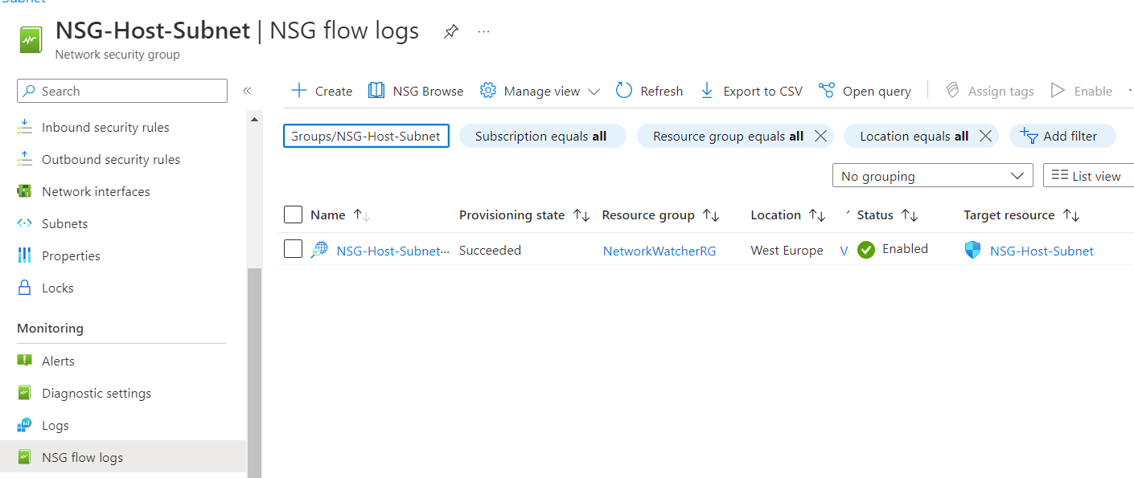
Flow Logs
In Network Security Groups

Slide 28
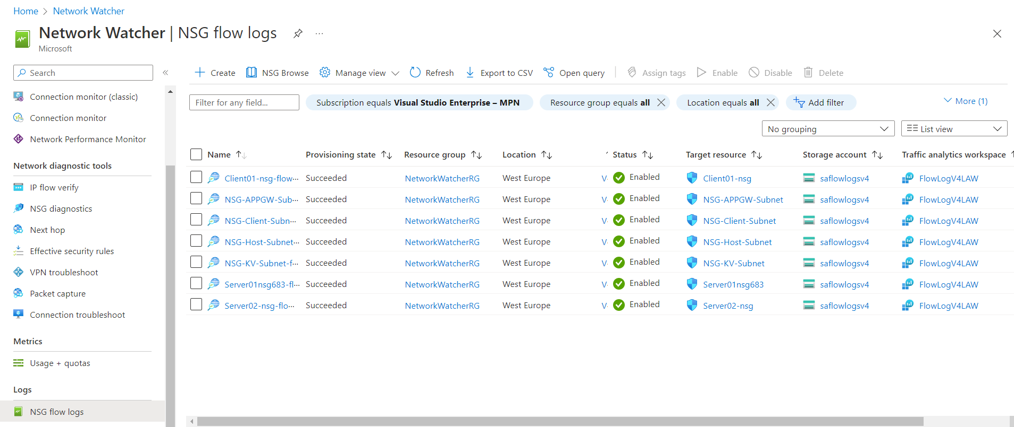
Flow Logs

Slide 29
Traffic Analytics
Network Watcher

Slide 30
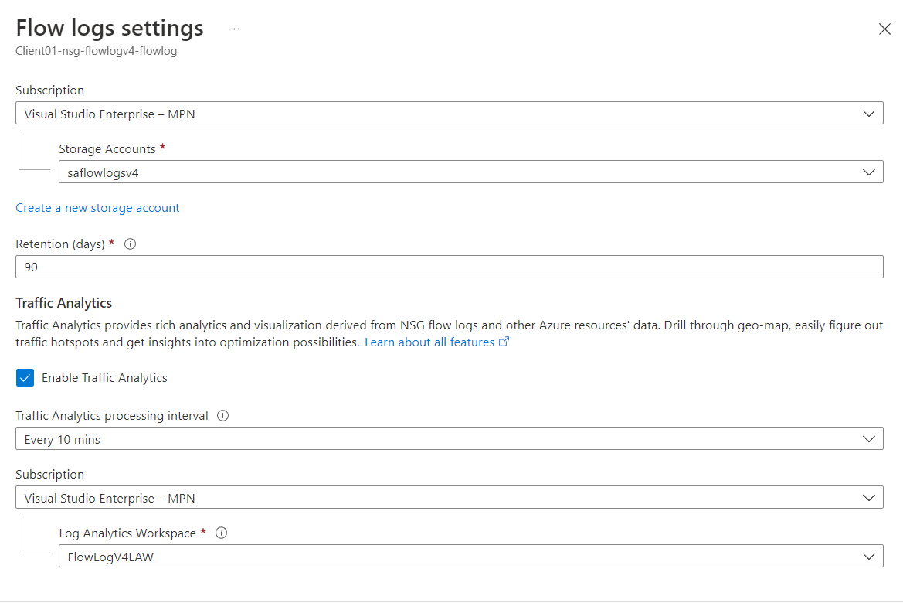
Traffic Analytics
Next step after flow logs
Enable in flow log settings
Process flow logs

Slide 31
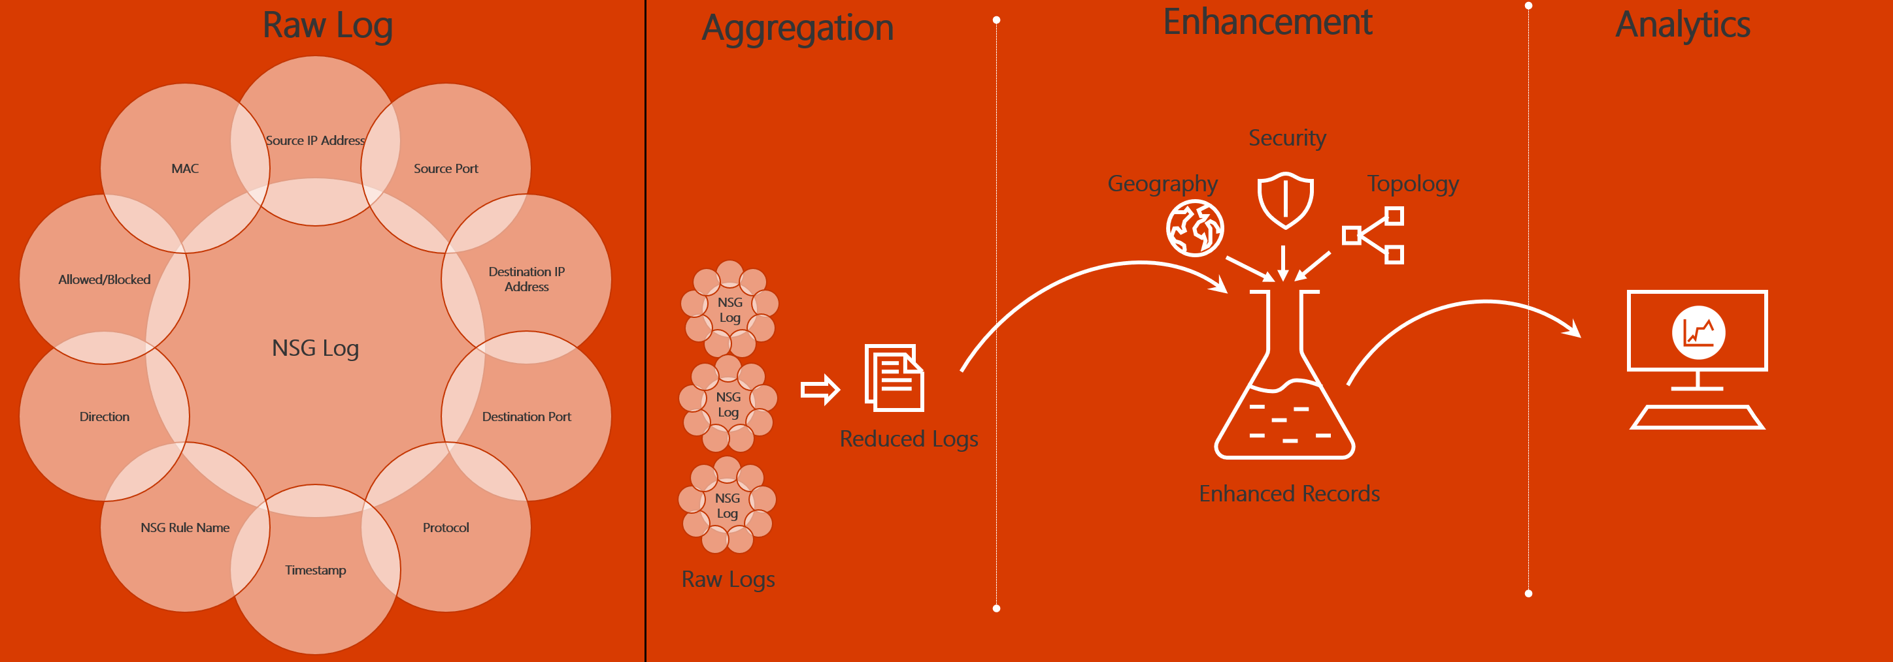
Traffic Analytics
Process Flow Logs

Slide 32
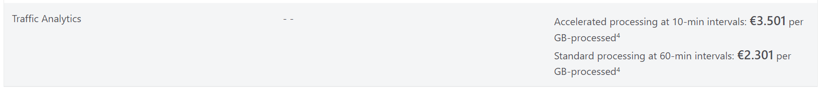
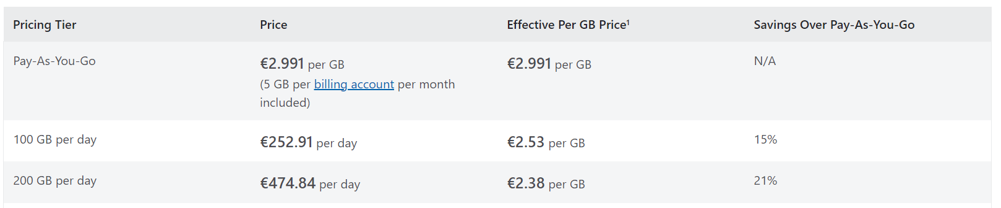
Traffic Analytics
Pricing
https://azure.microsoft.com/en-us/pricing/details/network-watcher/ https://azure.microsoft.com/en-us/pricing/details/monitor/

Slide 33
Traffic Analytics
Demo Environment
Private Link
Secrets
Management Machine
Webhosts

Slide 34
Traffic Analytics
Demo

Slide 35
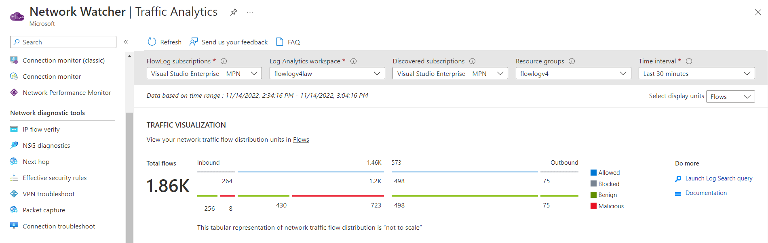
Traffic Analytics
Check in Network Watcher

Slide 36
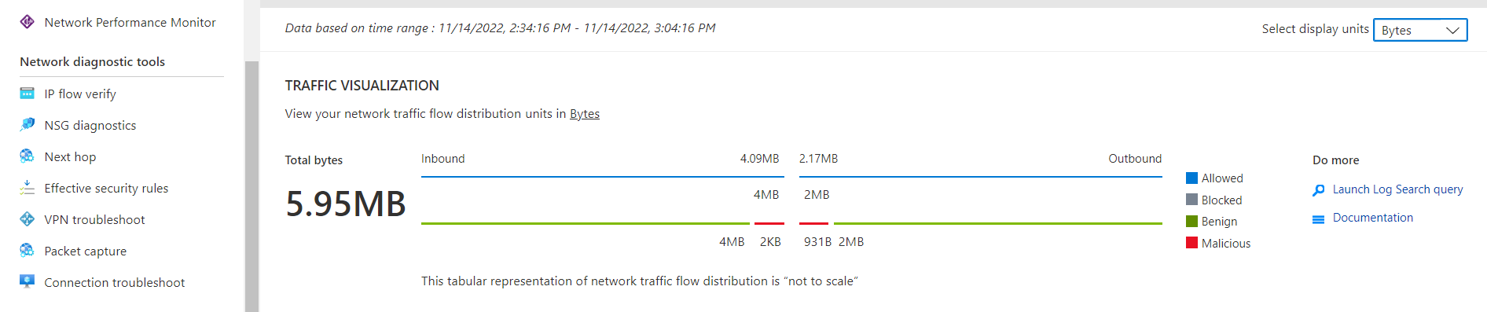
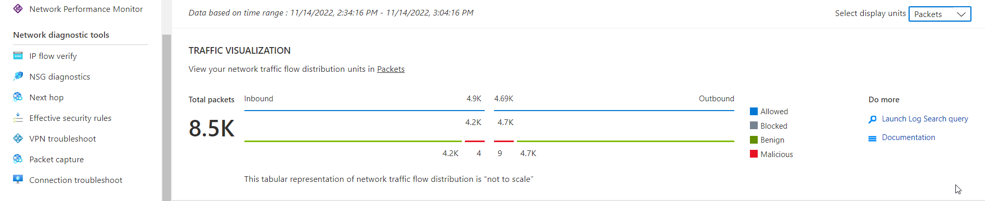
Traffic Analytics
Different Units

Slide 37
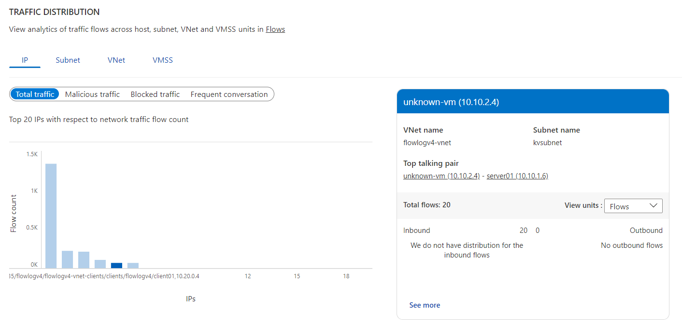
Traffic Analytics
Check usage

Slide 38
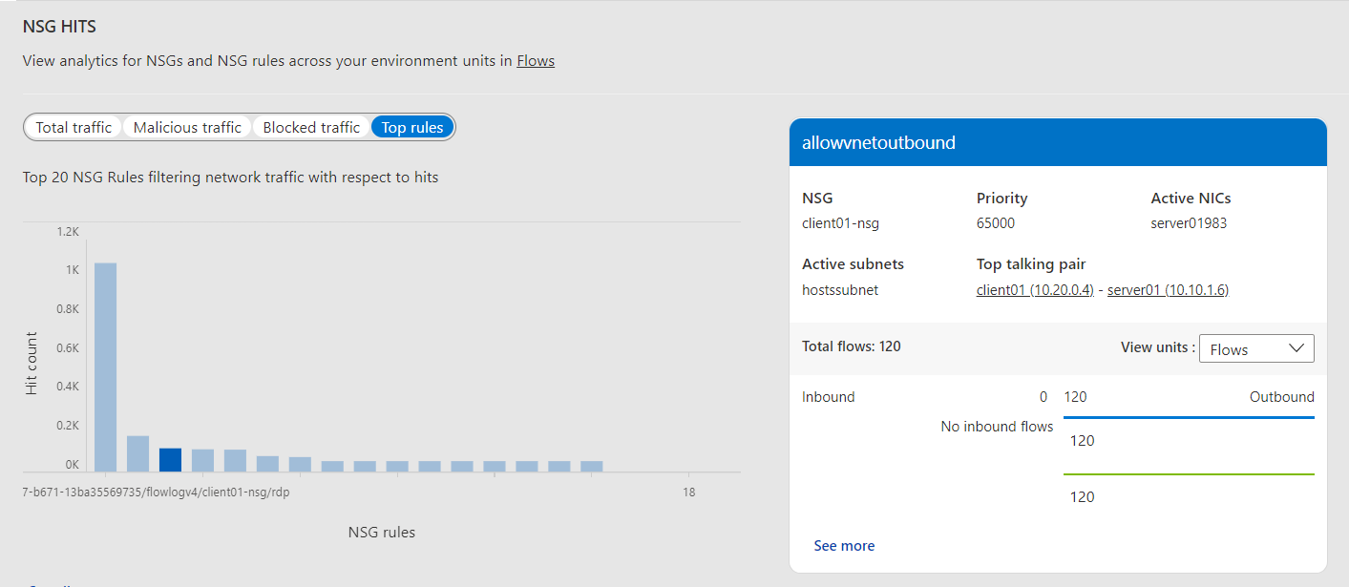
Traffic Analytics
Check usage

Slide 39
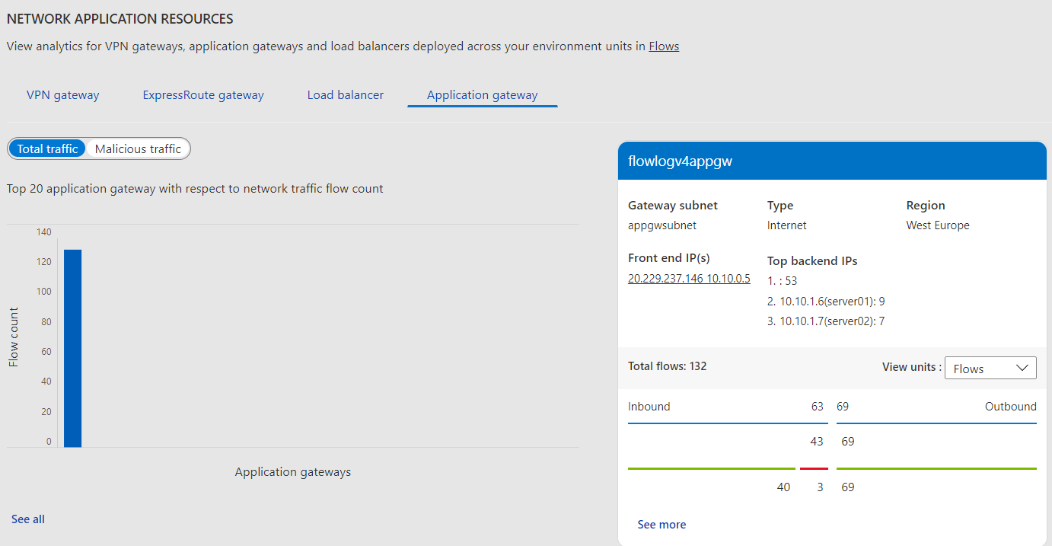
Traffic Analytics
Check usage

Slide 40
Detecting Mistakes
Using the traffic Analytics

Slide 41
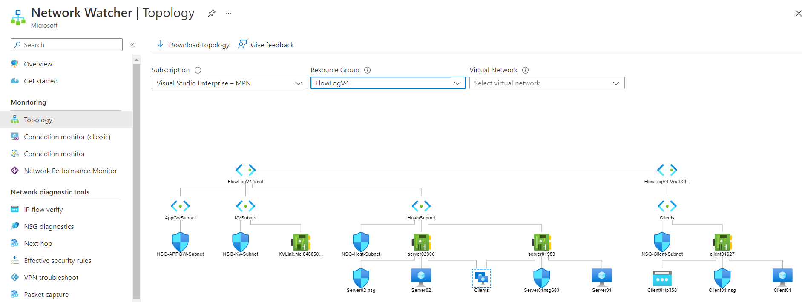
Detecting Mistakes
Check the topology

Slide 42
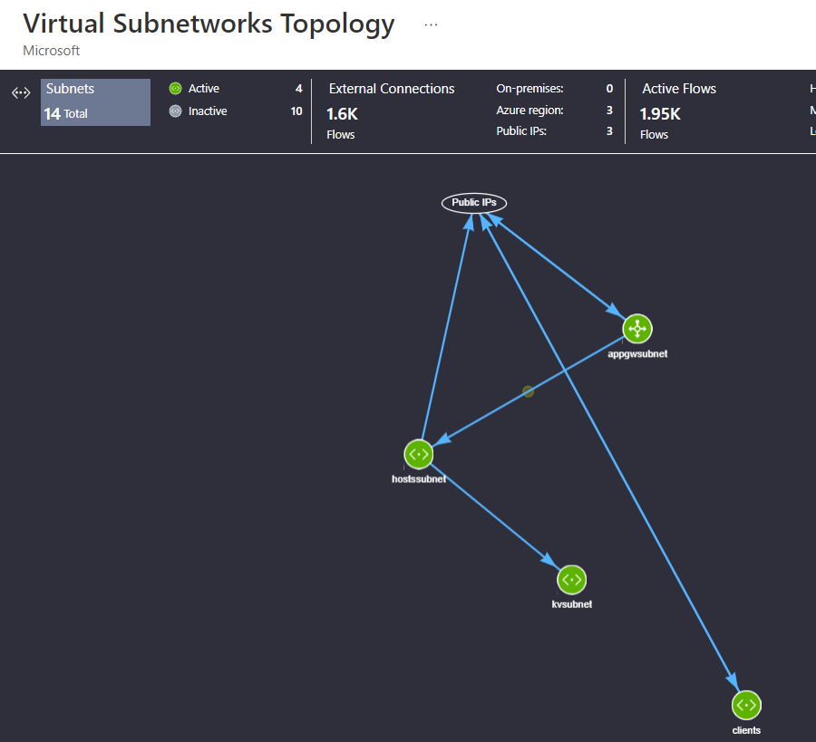
Detecting Mistakes
Visualize your network flows

Slide 43
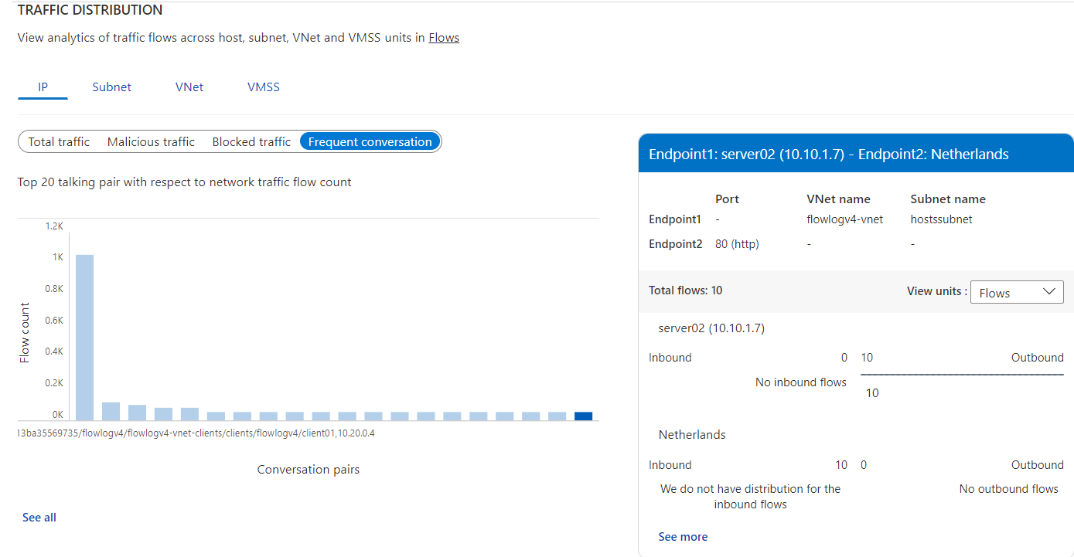
Detecting Mistakes
Check frequent conversations

Slide 44
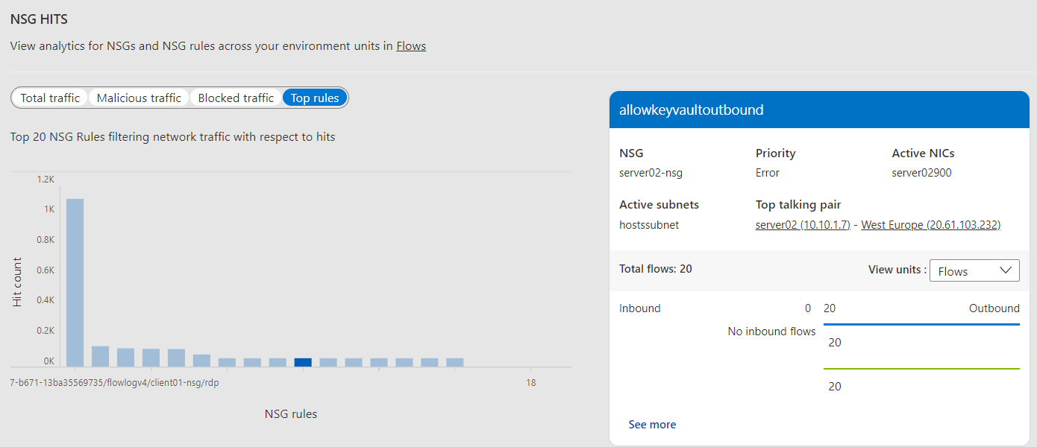
Detecting Mistakes
Check NSG Hits

Slide 45
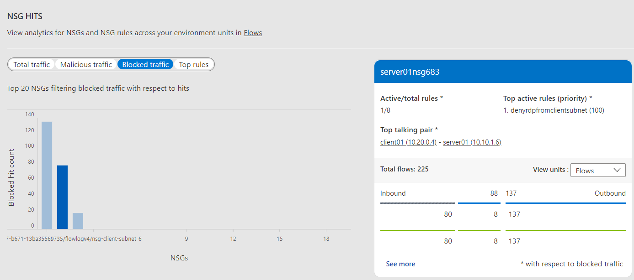
Detecting Mistakes
Check Blocked Traffic

Slide 46
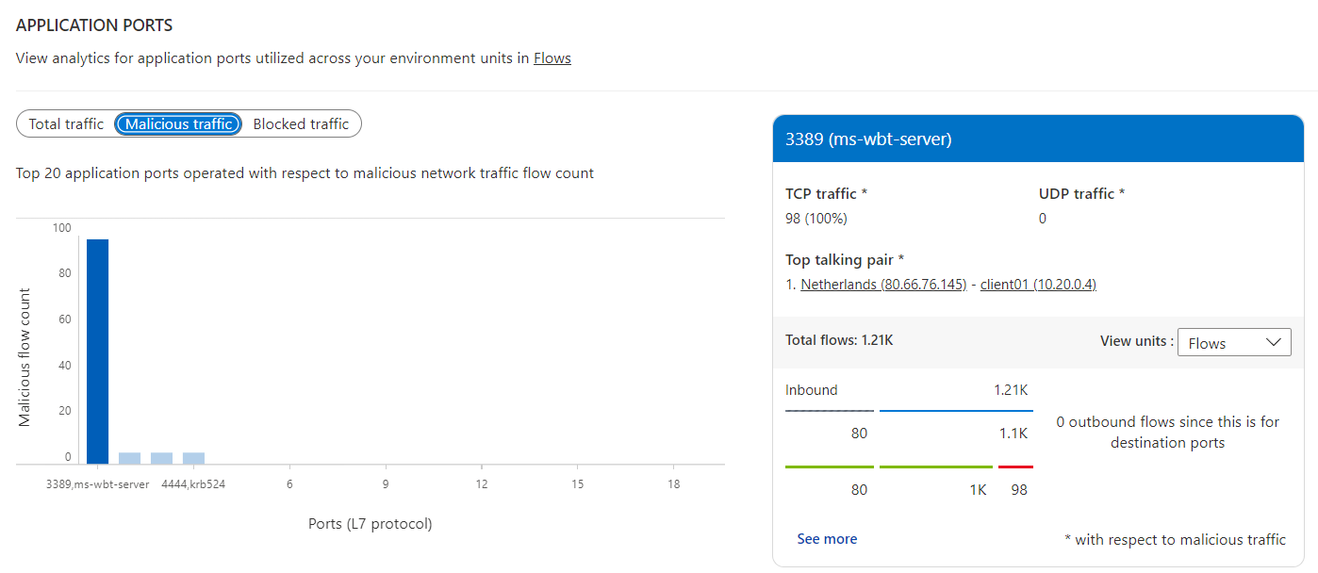
Detecting Mistakes
Check Application Port Usage

Slide 47
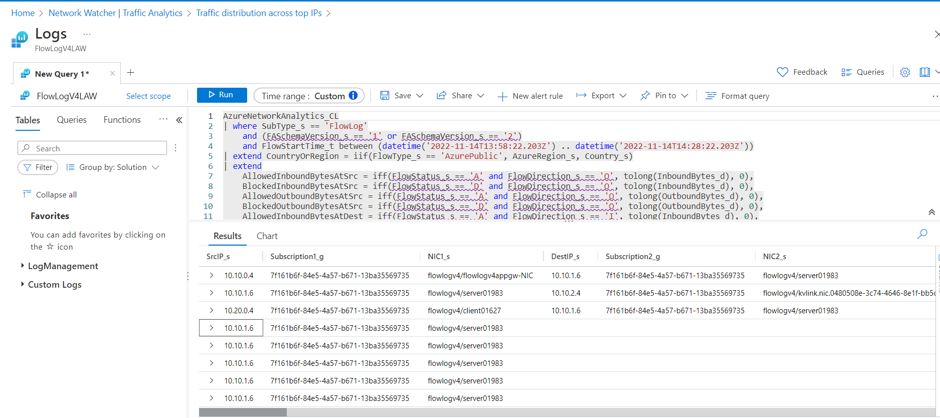
Detecting Mistakes
Drill Down

Slide 48
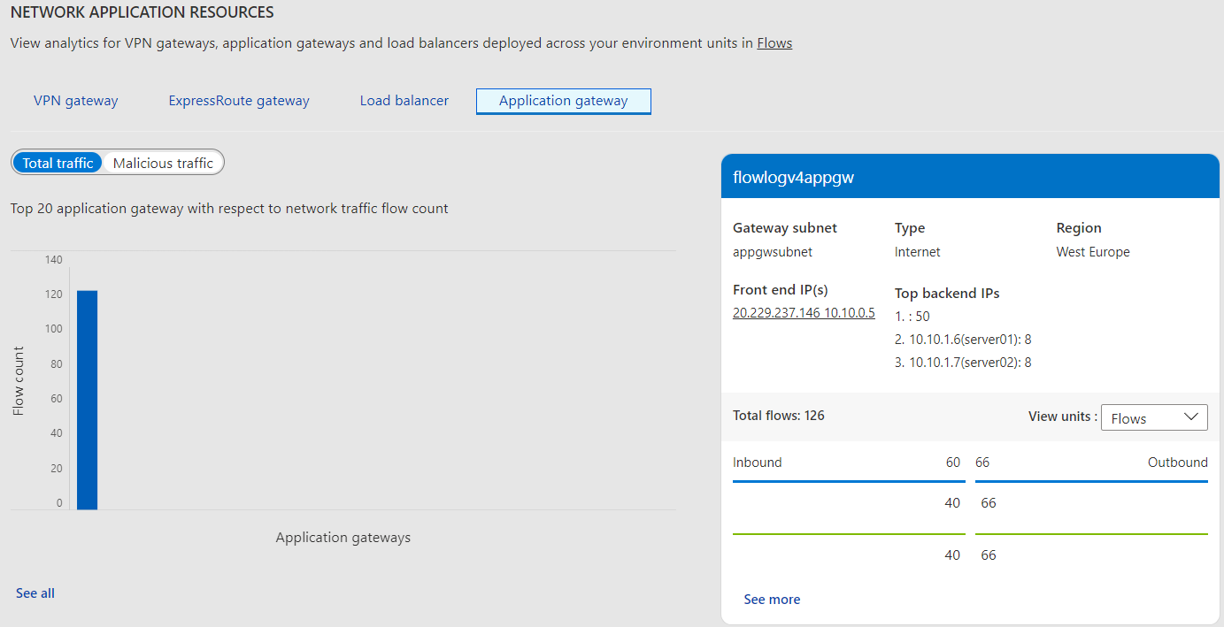
Detecting Mistakes
App Gateway Logs

Slide 49
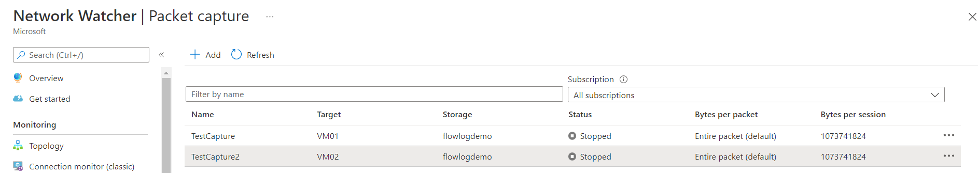
Detecting Mistakes
Use Captures

Slide 50
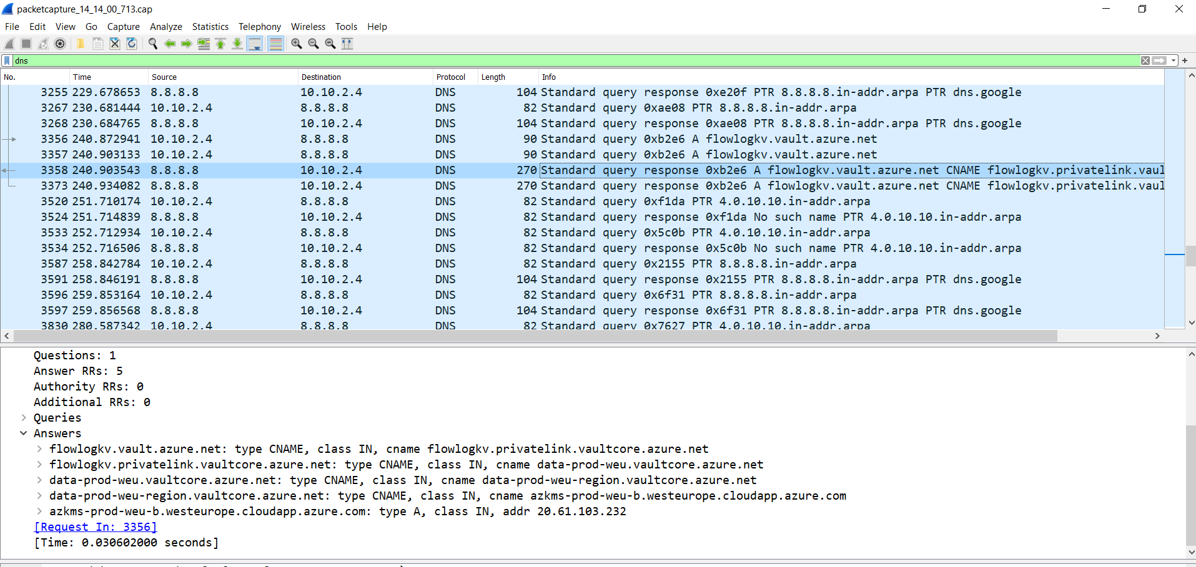
Detecting Mistakes
Use Captures

Slide 51

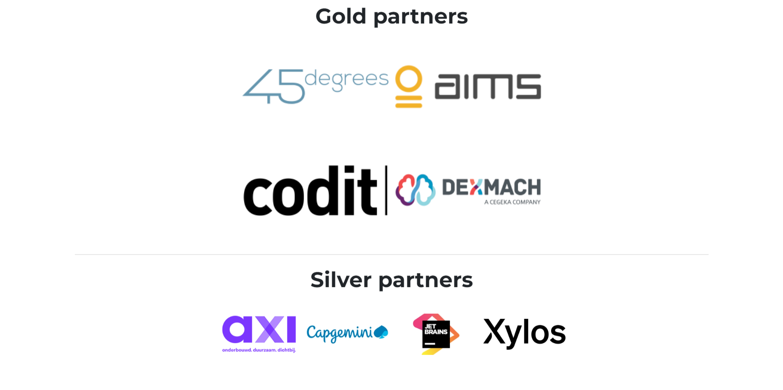

Thank you partners!

Slide 52
Thank you for listening!
Questions?
Leo Visser
Twitter: @autosysops
Blog: www.autosysops.com

